Slide 1
Hotel Reservation System
By
Shaik Akram

Slide 2
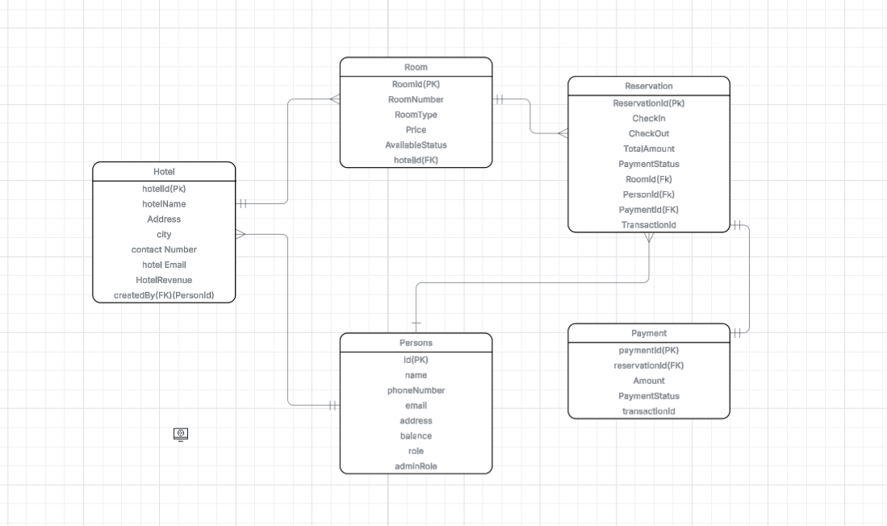
ER Diagram

Slide 3
Project Flow
Starting point Admin Admin Admin
1)Register 1)Add Hotel 1)Add Room 1)Edit profile
2)Login 2)Update hotel 2)Update Room 2)Delete Profile
3)Exit 3)delete hotel 3)Delete Room 3)Exit
4)view hotels 4)View Room
5)add room for a hotel 5)Exit
6)profile
7)Exit
          User User User
          1)View All Hotels 1)Reserve the Room 1)Edit Profile
          2)view hotels by city 2)Exit 2)Delete Profile
          3)profile 3)Add Balance
          4)Exit 4)View Booking Details

Slide 4
About
The Hotel Reservation System automates the process of booking rooms in hotels.
It allows users to search hotels, check room availability, and make reservations.
Admins can manage hotels, rooms, and user bookings.
Secure and reliable transaction process between user and hotel.

Slide 5
Technologies Used
Programming Language: Java (Core Java, OOPs, JDBC)
Database: MySQL
Backend Concepts: Exception Handling, Collections, File Handling
IDE: IntelliJ IDEA / Eclipse

Slide 6
Test case
Unit Testing done using Junit
Example: Assert that payment transaction succeeds/fails correctly
Tested scenarios:
          Valid booking
          Invalid hotel/room ID
          Insufficient balance
          Double Boking Prevention

Slide 7
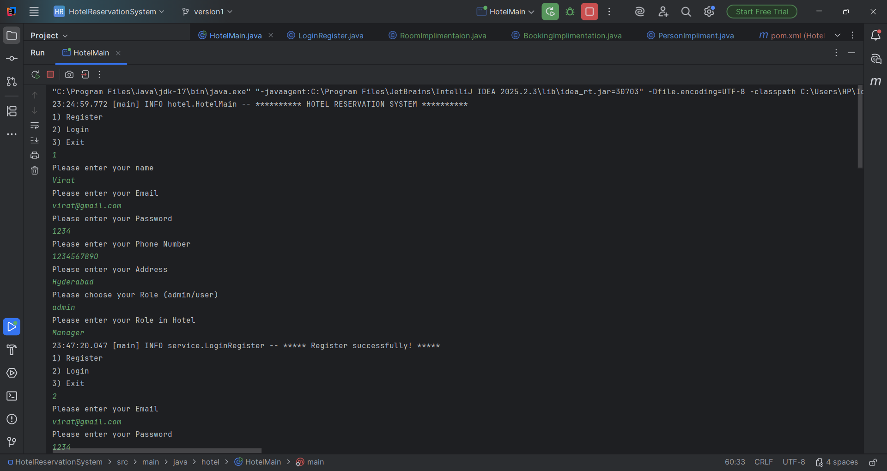

Slide 8
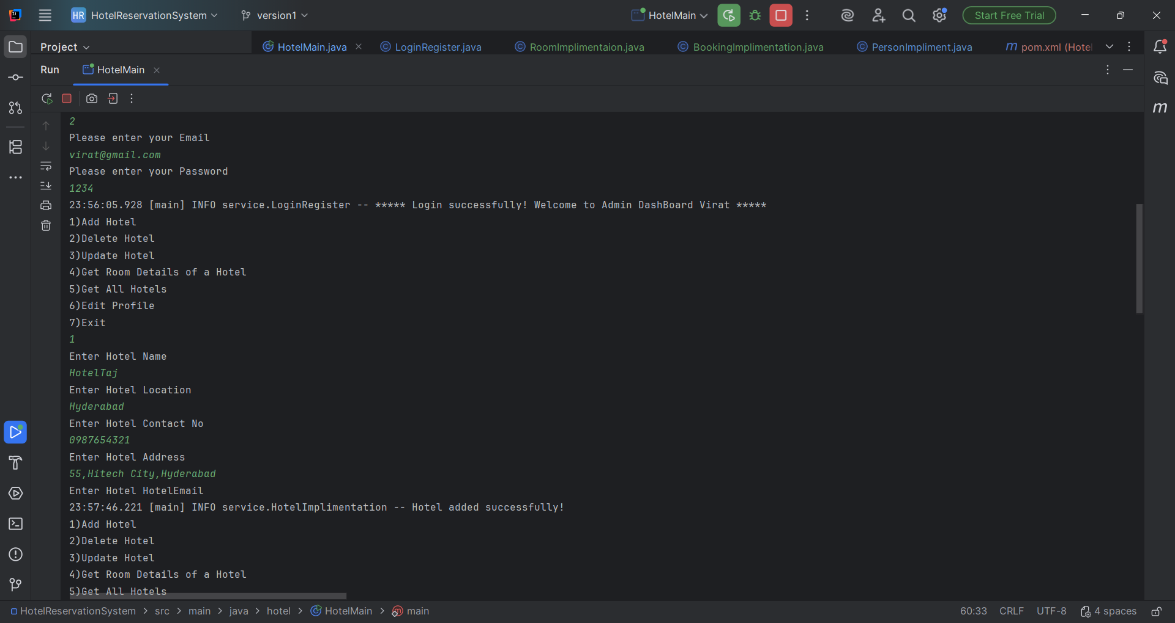

Slide 9
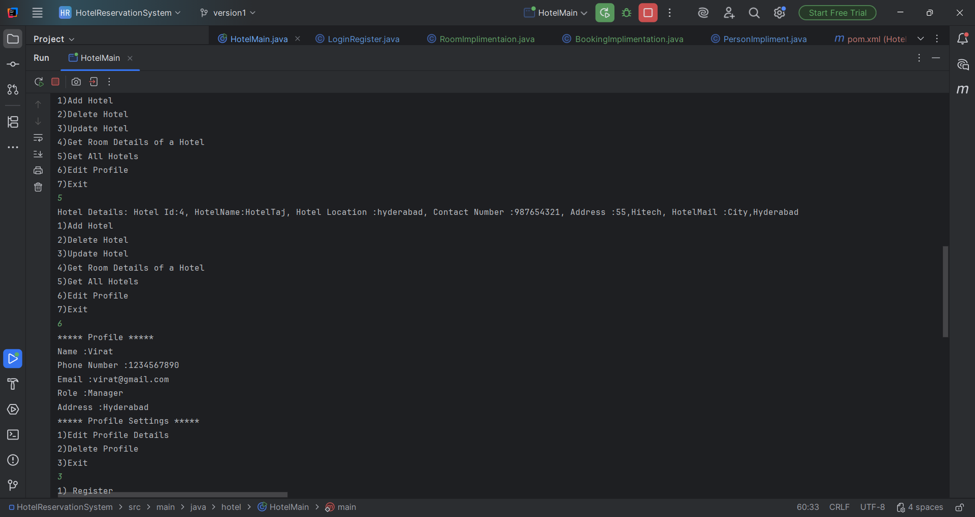

Slide 10
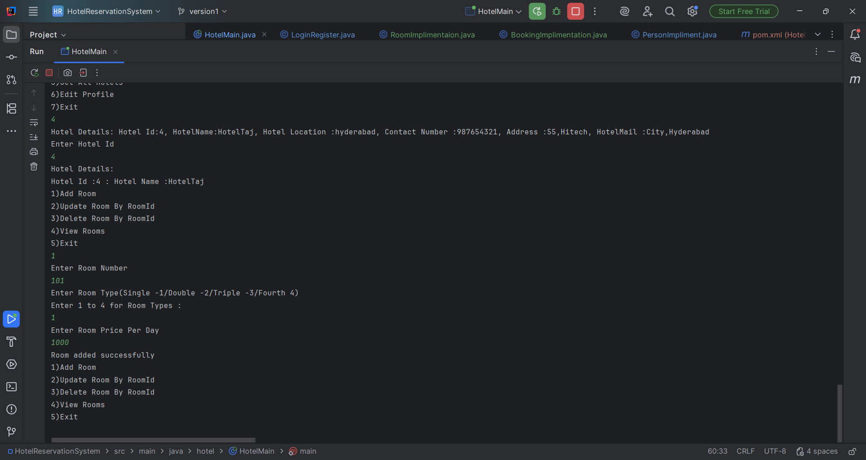

Slide 11
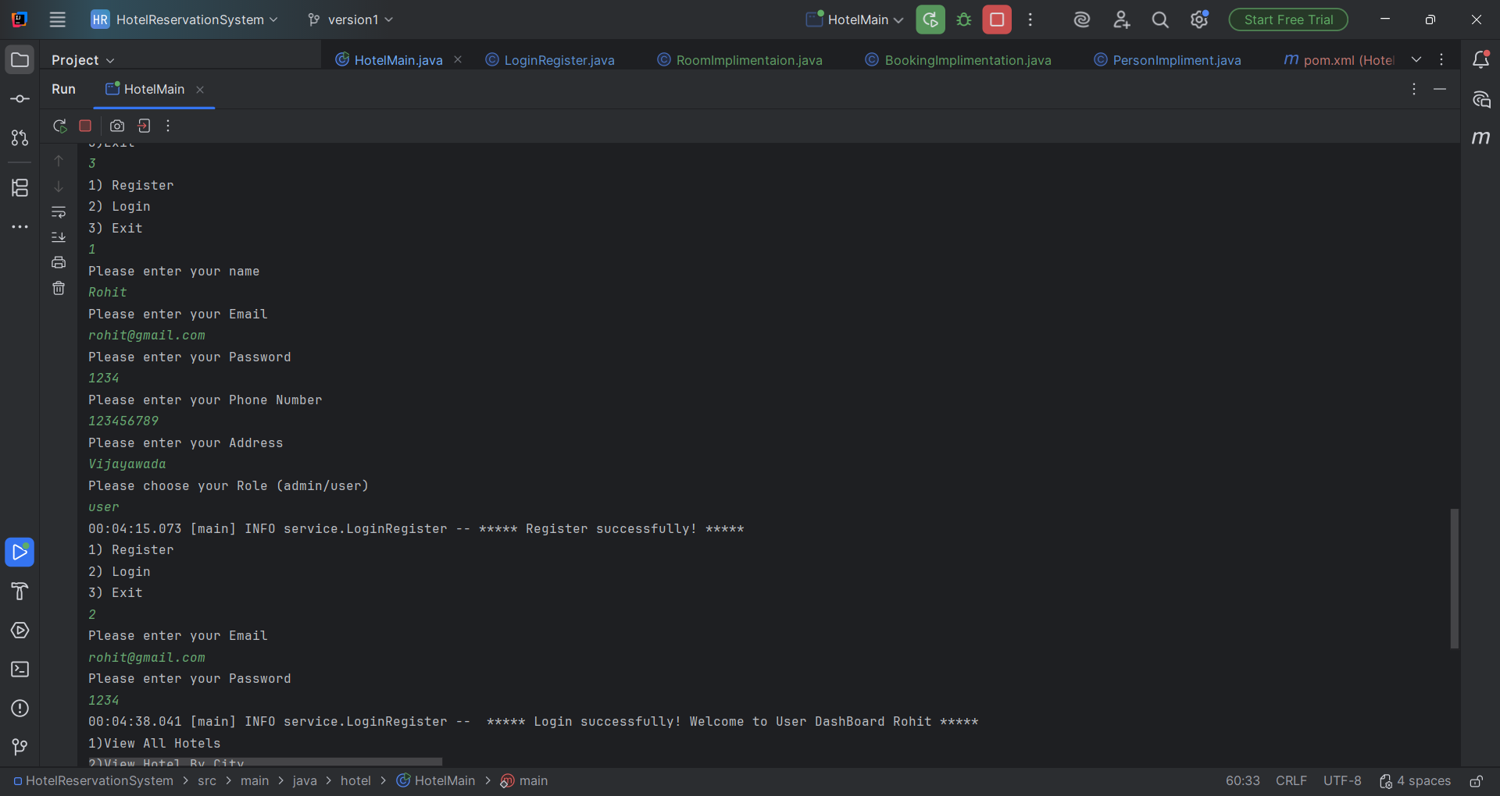

Slide 12
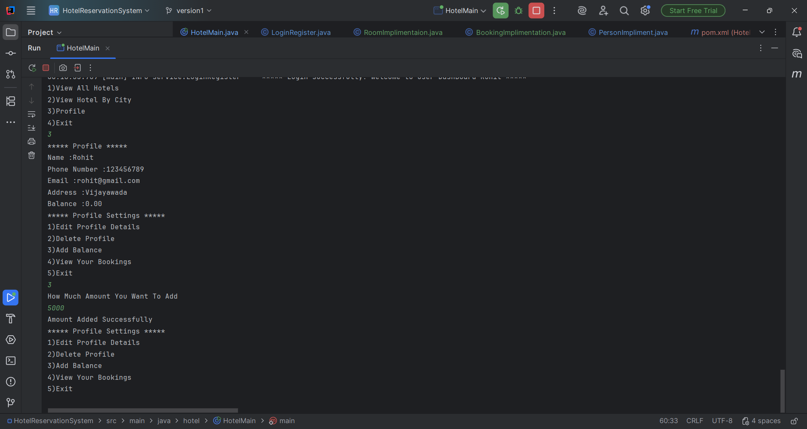

Slide 13
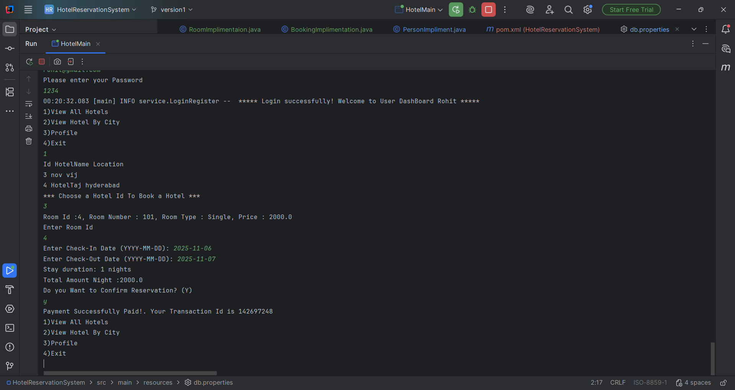

Slide 14
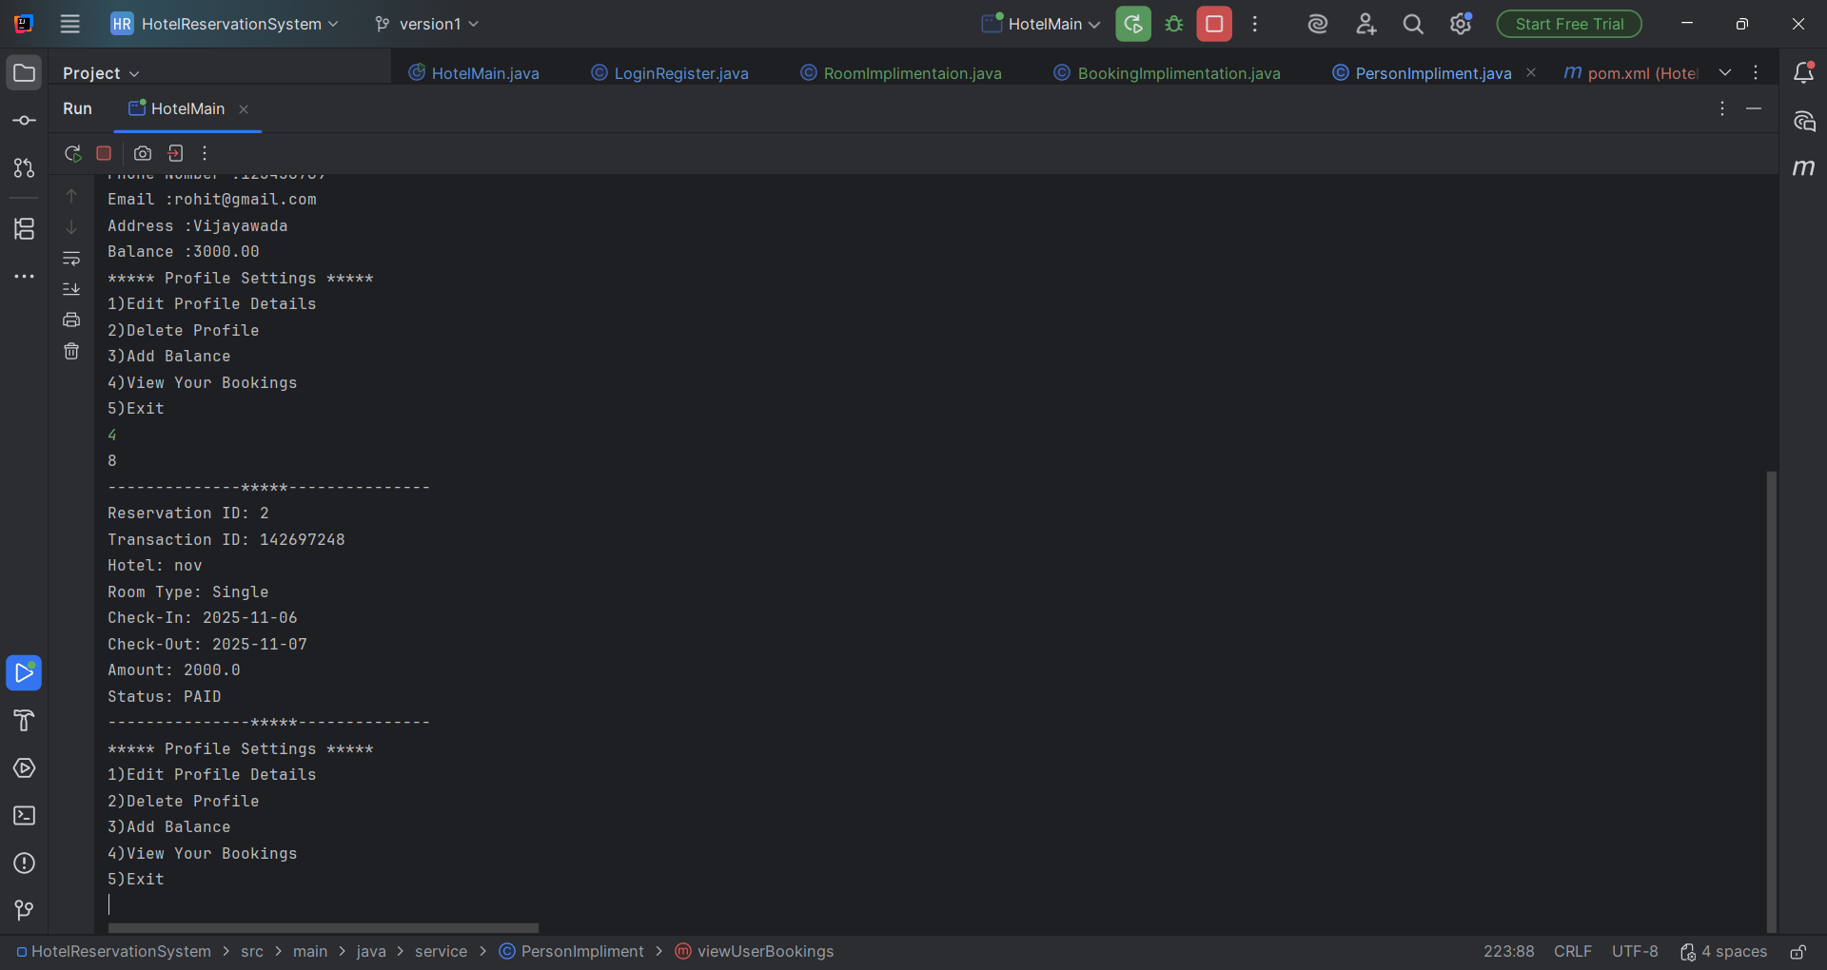

Slide 15
Thank You

